Slide 1
EES203: Geochemistry
Instructor: Anoop Ambili
Email id: anoop@iisermohali.ac.in

Slide 2
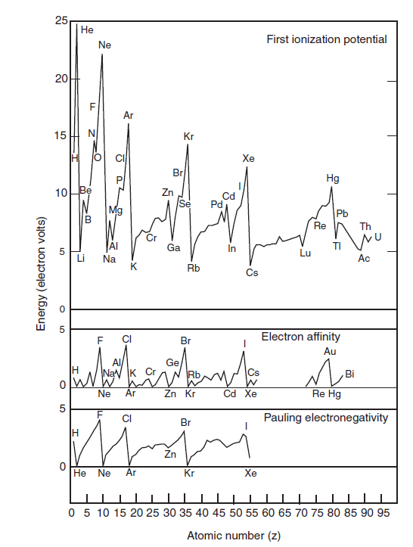
Properties of the elements

Slide 3
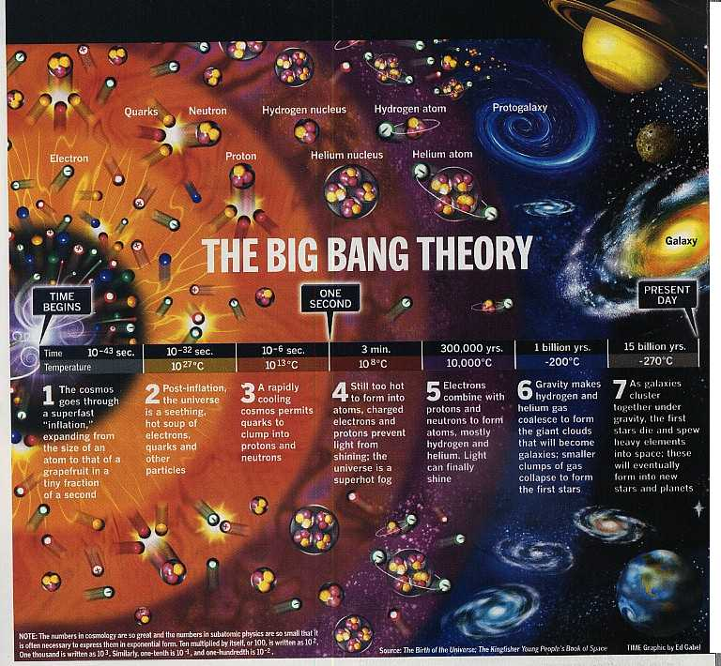
Cosmochemistry

Slide 4
The Big Bang
Event that occurred approximately 13-15 by
All the mass and energy concentrated at a point
The universe began expanding and continues to expand
After approx. 1 million years matter began to cool enough to form atoms- Hydrogen- the building block of stars

Slide 5
Galaxies and Stars
Galaxy- huge rotating aggregation of stars, dust, gas held together by gravity
Earth, the sun and our solar system is part of the Milky Way
Stars are massive spheres of incandescent gases (hydrogen and helium)

Slide 6
The Solar System
Our solar system is located away from the galaxy’s center
Our sun and the planets originated from a solar nebula that had been enriched with heavy elements
Solar system is approximately 5 Billion years old
Composition is 75% hydrogen, 23% helium and 2% other materials

Slide 7
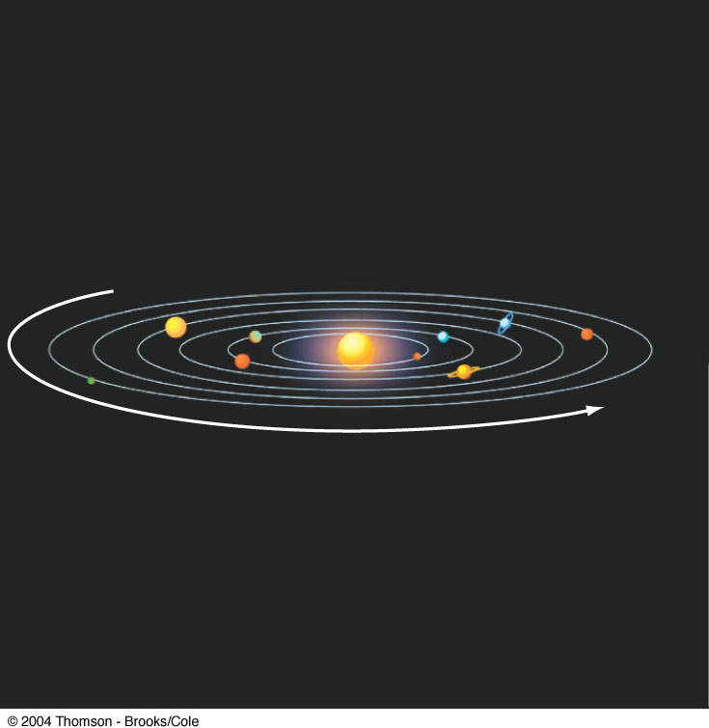
Our Solar System
4 inner planets (terrestrial)
4 outer planets (gaseous)

Slide 8
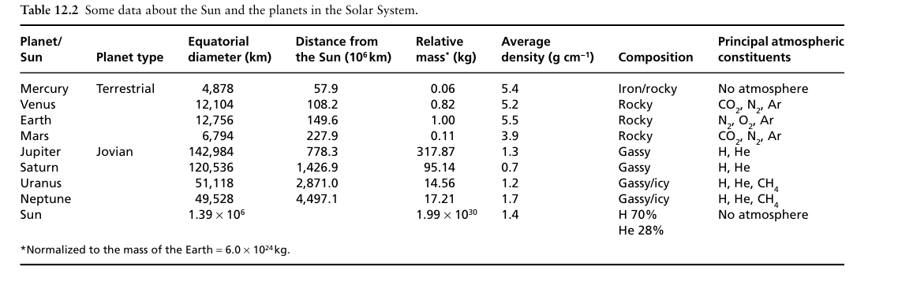

Slide 9
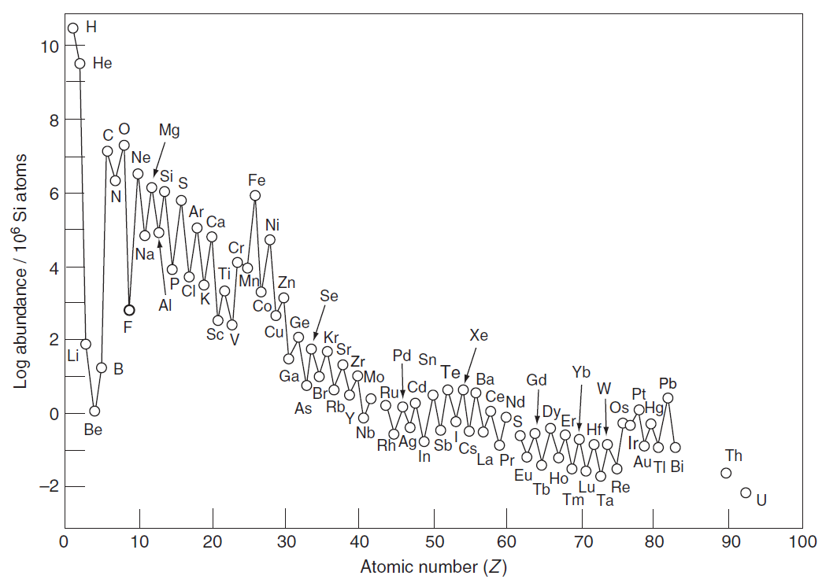
Solar system abundance of the Elements

Slide 10
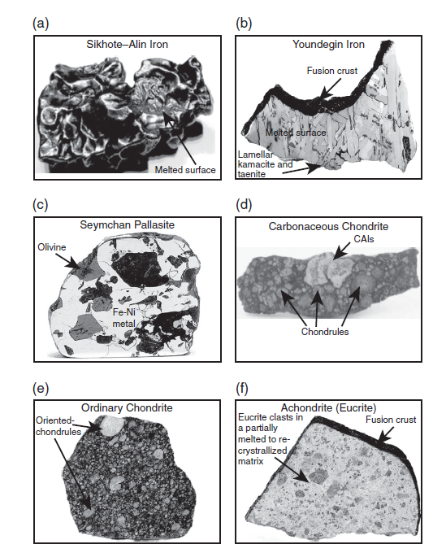
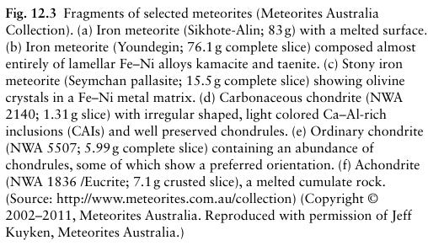
Information on elemental abundance

Slide 11
Bulk Earth = chondritic
We know the composition of the Earth’s crust
We have a good idea about the composition of the Earth’s mantle
We have no access to the core

Slide 12
Earth‘s interior
How to know the presence of discontinuities?
How to know the composition of diff layers?
Lithosphere, Asthenosphere
Crust – Mantle- Core

Slide 13
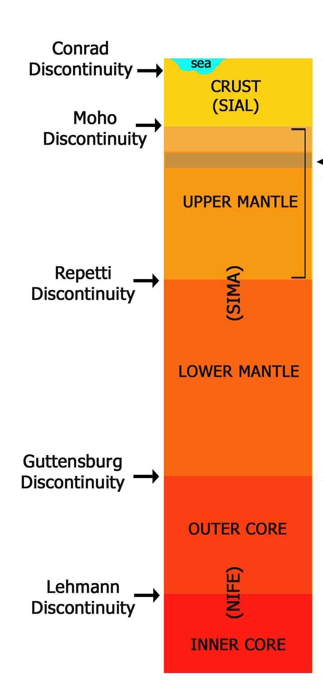
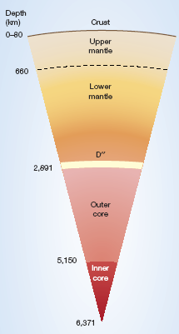
Seismic Constraints on the Earth‘s interior

Slide 14
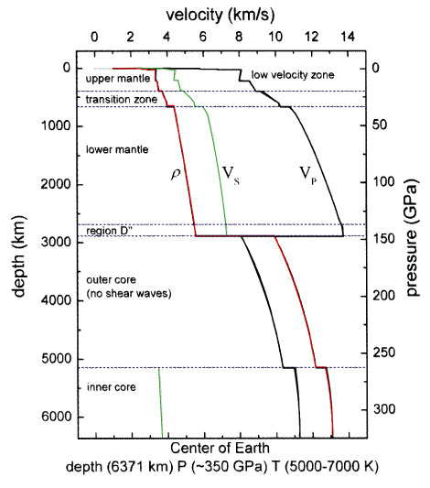
Seismic data:
Preliminary Reference Earth Model ‚PREM‘
(Dziewonski & Anderson 1981)

Slide 15
Based on mechanical behaviour
Lithosphere – outer rigid layer, Crust + upper mantle, Brittle, ~ 12km thick in MOR, ~150 - 200 Km thick
Asthenosphere – plastic, LVZ, base of lithosphere to ~400Km, flow takes place easily in asthenosphere, eventhough it is entirely solid
Mesosphere = 400-800km

Slide 16
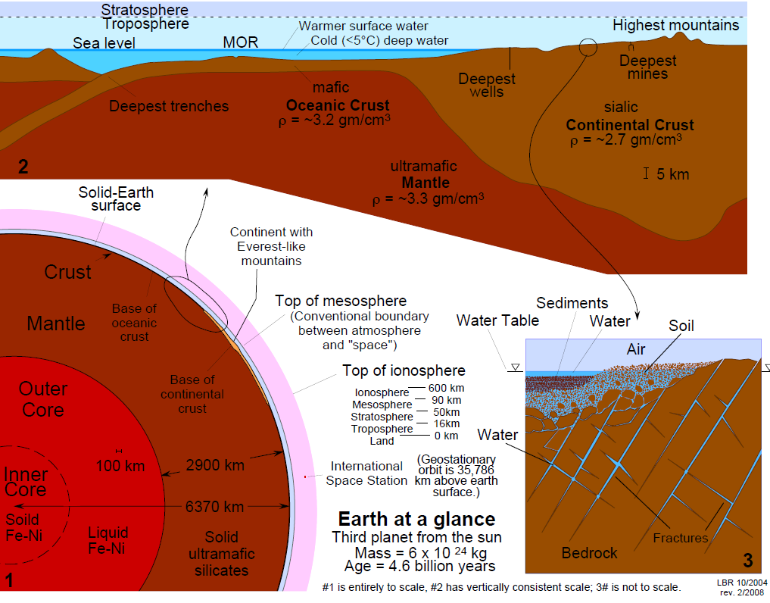

Slide 17












Abundance of the Elements The diagram below shows the relative abundance of the elements in the cosmos and in Earth’s crust.
10
9
8
7
6
5
4
3
2
1
0
-1
-2
H
He
Log atomic abundance per 10⁶ atoms of Si
C
O
Ne Mg Si _{S}
N
Ar
Ca
Cr
Ti
Fe
Ni
Na
Al P
Notable crustal depletion of non-gas elements relative to cosmic abundance
F
Cl
Zn
7
6
5
4
3
2
1
0
-1
-2
-3
Li
O
Si
V
Ge
Se
Kr Sr
Zr
B
Ca
Fe
Mo
Pd
Te Xe
Cosmic Abundance
Pb
H
K
Ga
Rb
Sn
Ba
La
Dy
Os
Hf
Pt
Mg
P
Ti
As
Nb
Sr _{Zr}
Ir
C
In
Sb
Eu
Re
Bi
S
Zn
Ba
Lu
N
Cr
_{Co} Cu
Br Y
Nd
Gd
Be
Sc
Ru _{Pd}
Sn
La
Er
Hf
(He)
Ge
Mo
Tl
Pb
Th
(Ne)
Crustal
W
U
Se
Bi
(Ar) Ag In
0 5 10 15 20 25 30 35 40 45 50 55 60 65 70 75 80 85 90 95
(Kr) (Xe)
Abundance
Au Hg
Z (atomic number)
Cosmic abundances are from Ahrens, L.H., 1965, Distribution of the Elements in our Planet: New York, McGraw-Hill, 110 p.; Crustal abundances are from Krauskopf, K.B., 1979, Introduction to Geochemistry (2nd edn.): New York, McGraw Hill, 617 p.

Slide 18
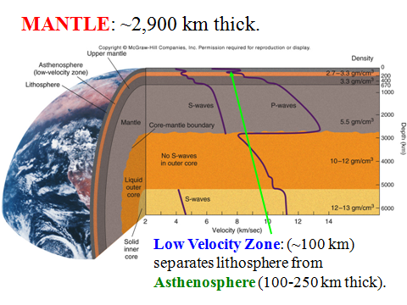
Mantle: 83% of the volume and 68.3% of the mass of the Earth

Slide 19
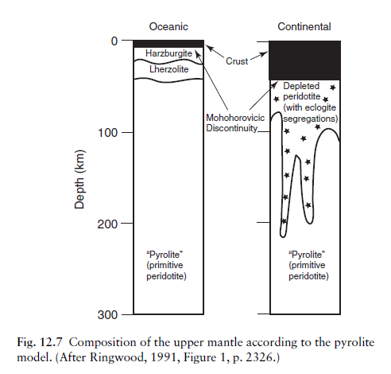

Slide 20
Lherzolite: A type of peridotite with Olivine > Opx + Cpx
Olivine
Dunite
90
Peridotites
Wehrlite
Harzburgite
Lherzolite
40
Orthopyroxenite
Olivine Websterite
Pyroxenites
10
10
Websterite
Orthopyroxene
Clinopyroxenite
Clinopyroxene
Figure 2-2 C After IUGS

Slide 21
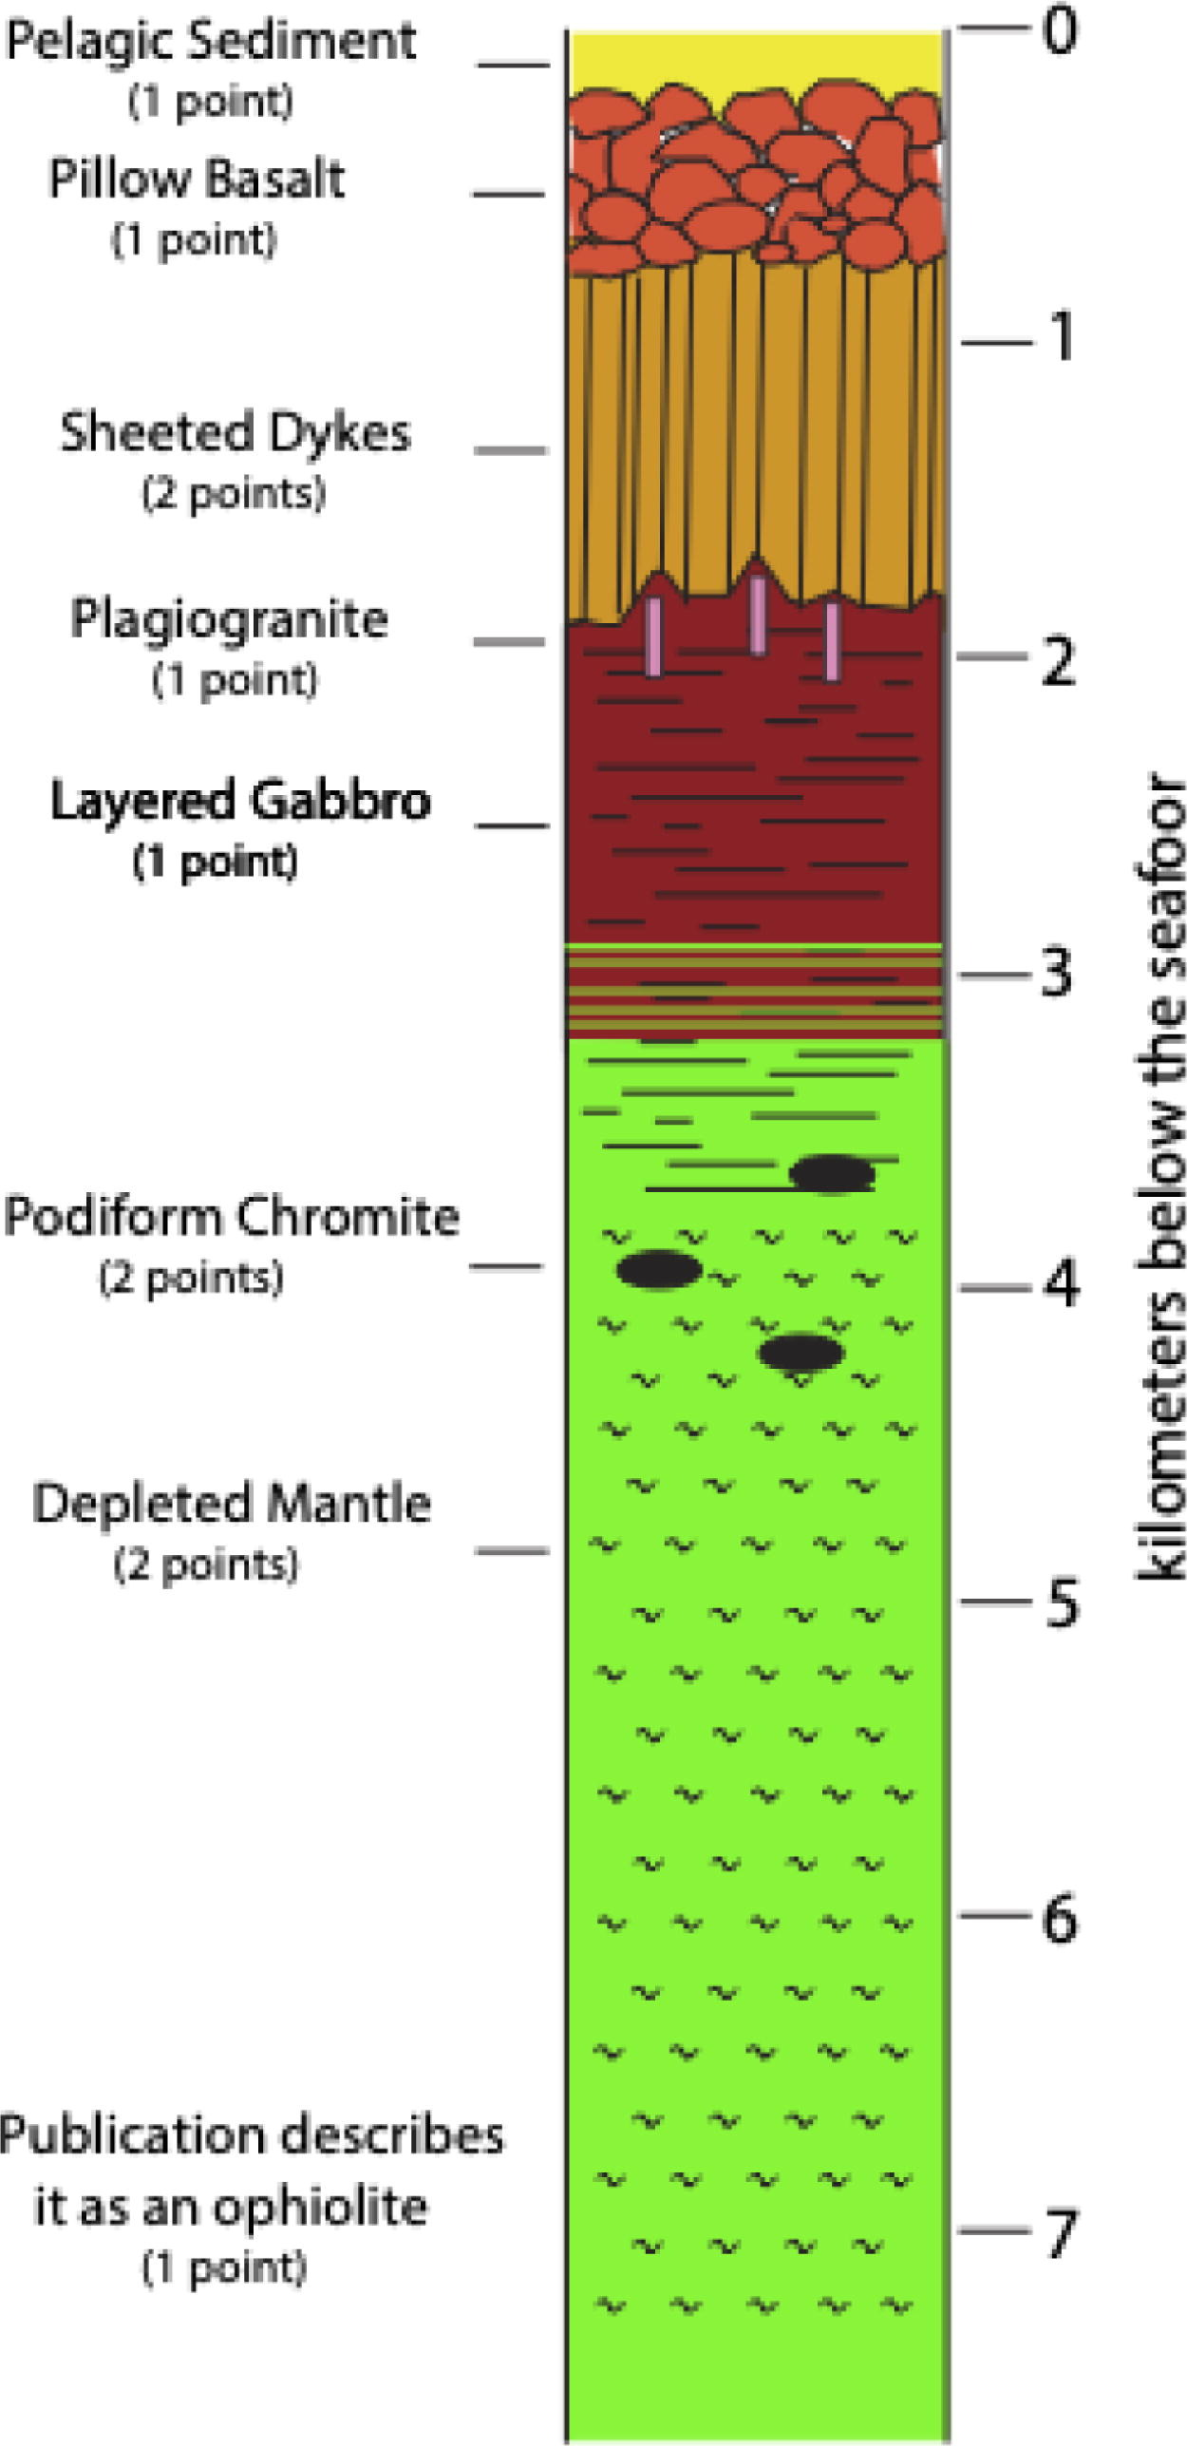
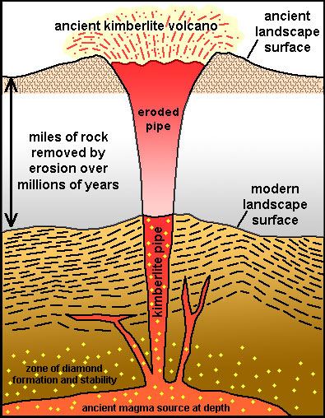
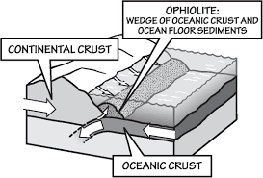

Slide 22
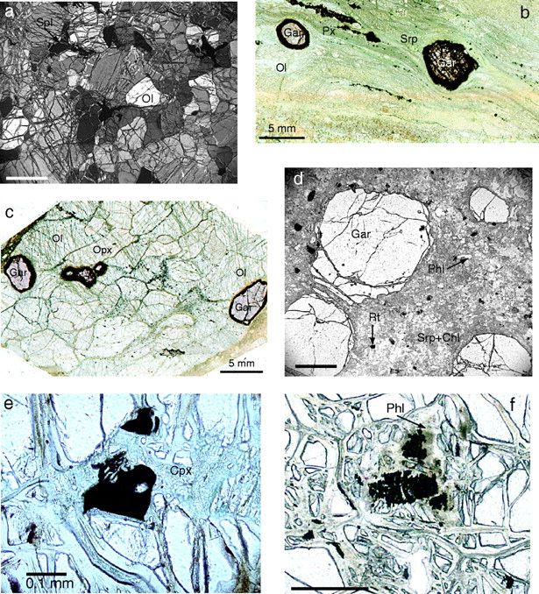

Fig. 2. Microphotographs showing textures of the SE Slave xenoliths.
Notes:
Fig. 2. Microphotographs showing textures of the SE Slave xenoliths. Mineral abbreviations here and below are from Kretz (1983). The scale bar represents 1 mm unless specified otherwise. (a) Coarse–equant texture of a spinel harzburgite xenolith. (b) Mosaic-porphyroclastic texture of a garnet peridotite xenolith. (Note bands of pyroxene neoblasts that define texture as laminated.) Garnets can be intact, non-disrupted, or disrupted and completely kelyphitized. (c) Coarse–equant texture of a garnet harzburgite xenolith. (d) Altered eclogite. Fresh grains of garnet and rutile are set in finer-grained serpentine and chlorite with laths of euhedral phlogopite. (e) Recrystallization of spinel into skeletal microlites is observed only on the side adjacent to a secondary interstitial clinopyroxene. (f) Complete recrystallization of spinel into smaller skeletal microlites inside a phlogopite-rich area of peridotite.
Unless provided in the caption above, the following copyright applies to the content of this slide: Journal of Petrology 45(5) © Oxford University Press 2004; all rights reserved.

Slide 23
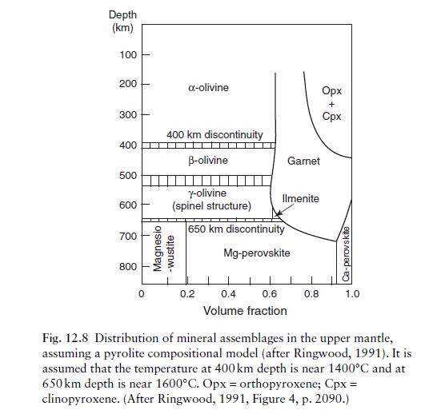

Slide 24
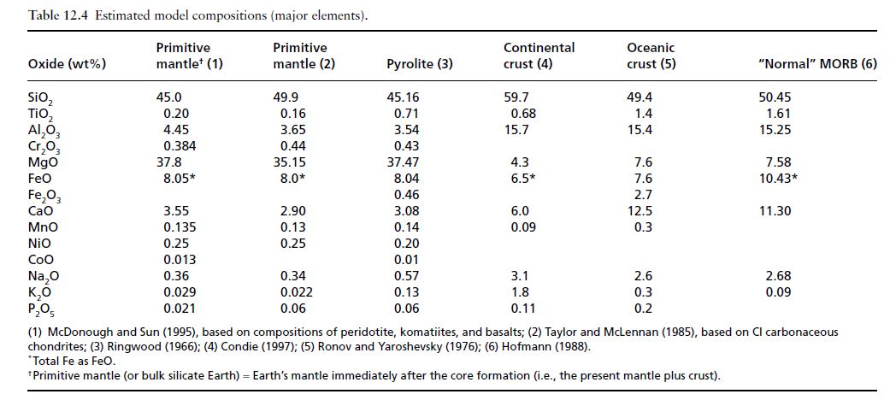

Slide 25
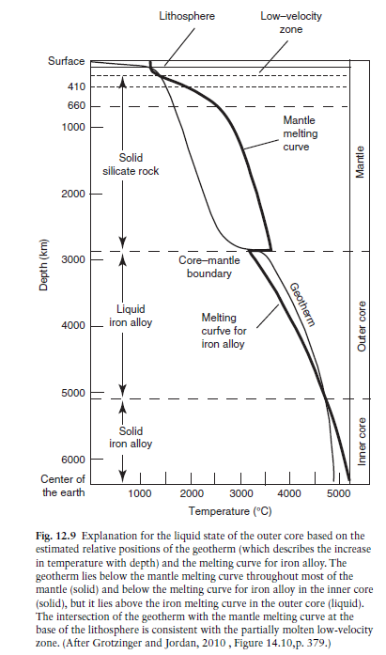
The Earth’s core comprises about 16% of the Earth’s volume and 31% of the Earth’s mass.
composition for the core (in wt%): Fe – 85.55, O – 5.18, Ni – 4.88, S – 2.69, Cr – 0.45, Mn – 0.41, P – 0.35, Co – 0.22, Cl – 0.07, and possibly K – 0.02

